Slide 1
Unit- 5 Industrial Applications/Case Studies
Dr. Madhukrishna Priyadarsini
Department of CSE

Slide 2
Outline:
Cisco IoT system
IBM Watson IoT platform
Converged Plantwide Ethernet Model (CPwE)
Power utility industry
GridBlocks Reference model
Smart and connected cities (Layered architecture, smart lighting, smart parking architecture and smart traffic control)

Slide 3
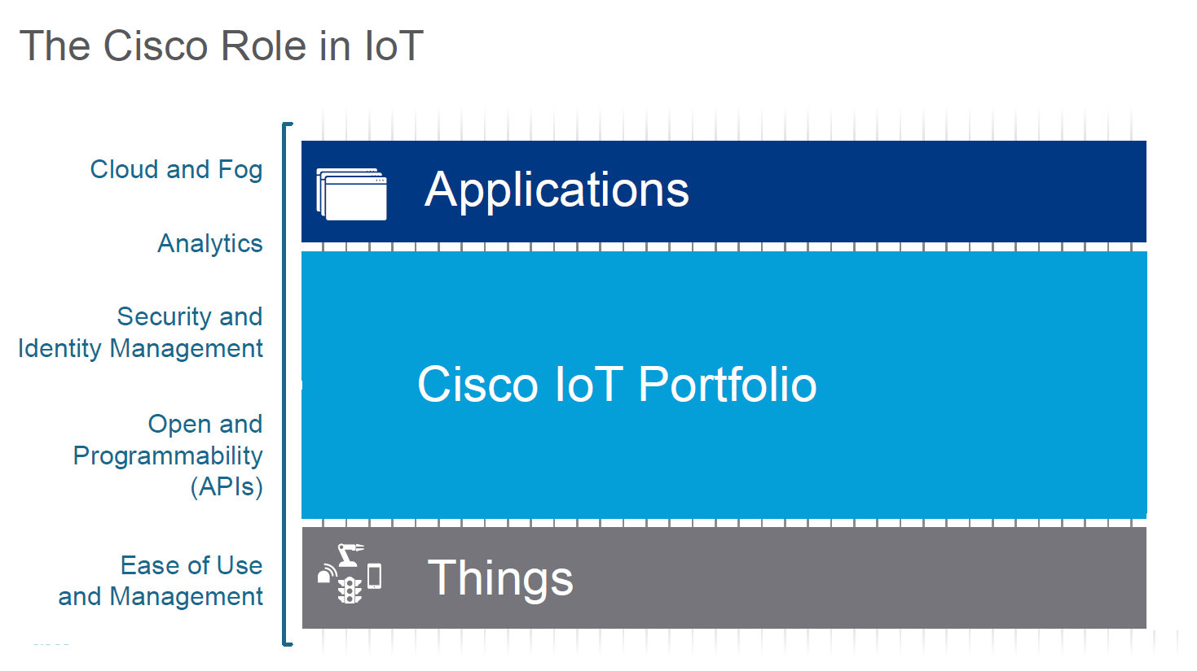
Cisco IoT System
Deploying IoT requires configuring and managing countless assets and dealing with complex operational and industry requirements. Moreover, it creates potential blind spots that increases security risks.
Cisco provides the most secure dependable IoT platform in the market.

Slide 4
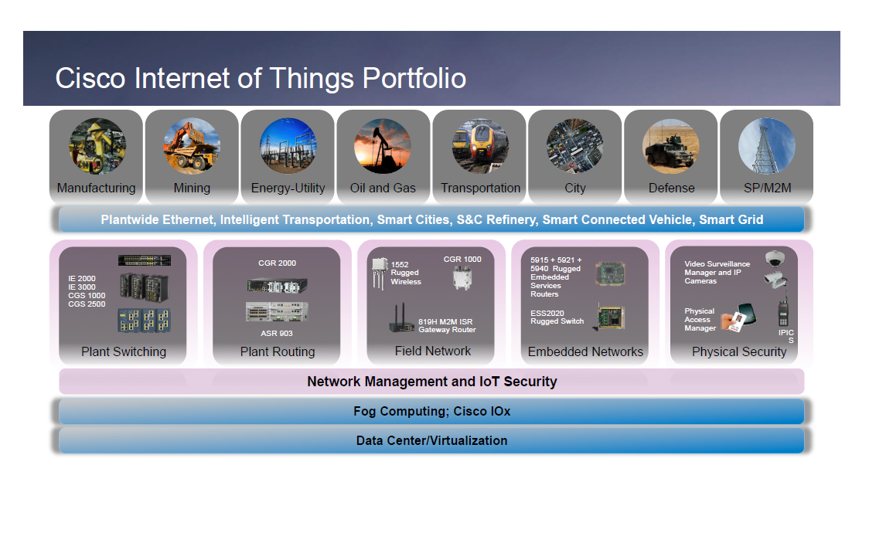

Slide 5
Six pillars of Cisco IoT system:
Network Connectivity-> This pillar includes purpose-built routing, switching, and wireless products which can withstand rough treatment.
Fog Computing-> It enables customers “to analyze and manage data locally, and thereby to derive immediate insights from connections”. Cisco predicts that 40 per cent of IoT-created data will be processed in the fog by 2022 while over 25 of Cisco’s network products are enabled with Cisco’s fog computing or edge data processing platform, IOx.
Data Analytics-> The Cisco IoT System provides an optimized infrastructure to implement analytics and harness actionable data for both the Cisco Connected Analytics Portfolio and third party analytics software.
Security-> The security pillar of the IoT System unifies cyber and physical security to deliver operational benefits and increase the protection of both physical and digital assets. Cisco’s IP surveillance portfolio and network products with TrustSec security and cloud/cyber security products allow users to monitor, detect and respond to combined IT and Operational Technology (OT) attacks.
Management and Automation-> The IoT System provides enhanced security, control and support for multiple siloed functions to deliver an easy-to-use system for managing an increasing volume of endpoints and applications, field operators need an easy-to-use management system.
Application Enablement Platform-> Offers a set of APIs for industries and cities, ecosystem partners and third-party vendors to design, develop and deploy their own applications on the foundation of IoT System capabilities. Furthermore, Cisco has also introduced more than 15 new IoT products around network connectivity, physical and cyber security, data analytics, management and automation which will serve industry verticals such as manufacturing, oil and gas, utilities, transportation, public safety and smart cities.

Slide 6
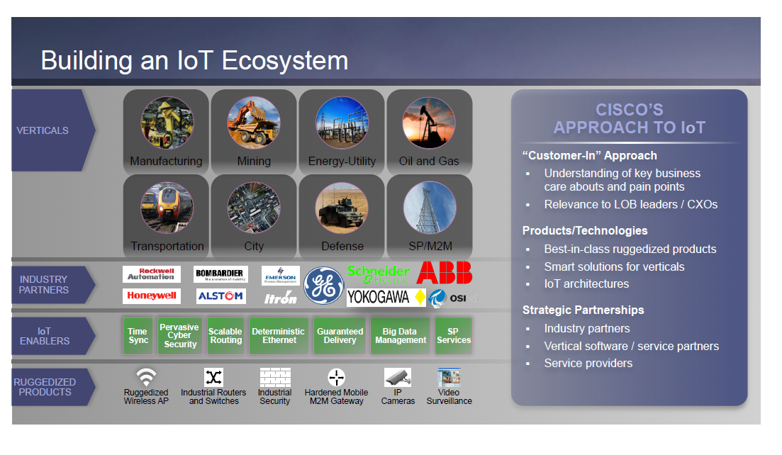

Slide 7
IBM Watson IoT Platform
Watson IoT Platform and its additional add-on services enable organizations to capture and explore data for devices, equipment, and machines, and discover insights that can drive better decision-making.
It integrates the existing capabilities and functions of IBM IoT Connection Service in an end-to-end, fully managed cloud service available for subscription in production or non-production environments.
Watson IoT Platform communicates with your applications and devices by using the Watson IoT Platform API and the Watson IoT Platform messaging protocol. Other capabilities include:
Appliance claiming
Device registration and set-up
Authentication and security
Data life cycle management
Device management
Alerts and remote monitoring
Solution administration

Slide 8
Accelerate development and PoCs with production and non-production subscriptions
Watson IoT Platform for Production subscription is available in various implementation sizes and scales:
Sensor
Consumer
Enterprise
Industrial
Watson IoT Platform also provides a non-production environment for developing application content and conducting Proofs of Concept (PoC).
The non-production environment can quickly conduct an IoT PoC and move development from non-production into production.
Users can easily simulate device deployment; authenticate, claim, or register a device; create dashboards and groups; deploy alerts; and utilize at global scale.
The Watson IoT Platform Lite Plan on the IBM Cloud offers 500 registered devices, 500 application bindings, and 200 MB of each of data exchanged. This includes data analysis and edge data analysis at no charge.

Slide 9
Enrich and extend the Watson IoT Platform with optional add-ons
Watson IoT Analytics service is an extension to the Watson IoT Platform. It enables line-of-business users to easily enrich, augment, and interact with the raw data that is originating from the IoT Platform with additional analytical measures and configurable business rules to get a better view of their operations and business.
Watson IoT analytics service:
Offers support for creating, monitoring, and enforcing business-relevant analytic functions.
Provides a user interface that automates the workflow of gathering input data for analytic function calculation from multiple sources; defining input data to perform calculations; acting on the calculated values; and storing the calculated results.
Enables developers to create and publish custom analytic functions onto the catalog through a python-based API.
Watson IoT Blockchain service is an extension to the Watson IoT Platform. It enables Internet of Things (IoT) and assets to validate provenance and events in a trusted, immutable ledger that is designed to increase trust and transparency across ecosystems.

Slide 10
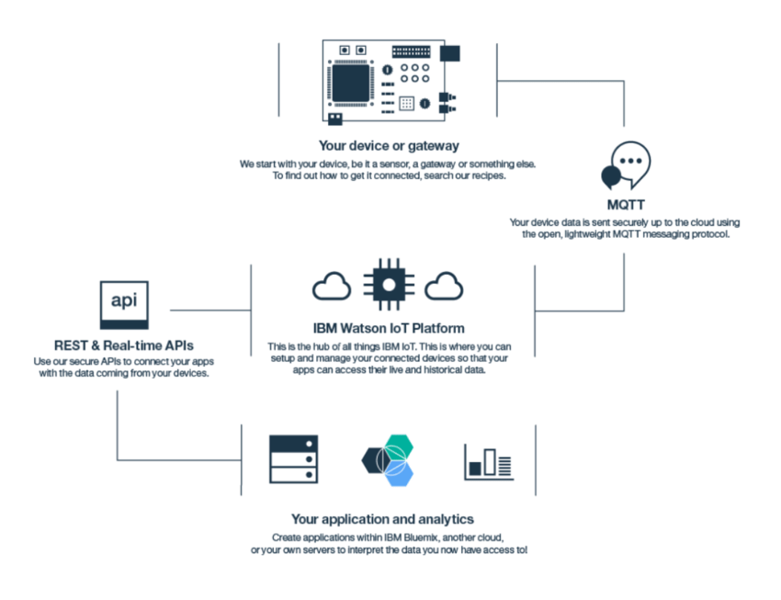
IBM Watson IoT Platform Functionalities:

Slide 11
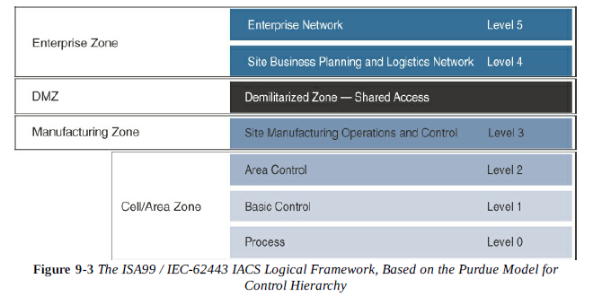
Converged Plantwide Ethernet Model (CPwE): Manufacturing Industry
CPwE is an architectural framework that provides network services to industrial automation and control systems (IACS) devices and equipment and promotes secure integration into the enterprise network.
Industrial Automation and Control Systems Reference Model (IACS):

Slide 12
The IACS logical framework identifies functional zones and levels of the manufacturing plant and defines operations at each level. These zones are defined as follows:
Safety Zone->A hardwired fail-safe used to protect personnel and equipment if a dangerous event occurs.
Manufacturing Zone->All IACS applications, devices, and controllers critical to monitoring and controlling plant IACS operations are here.
Cell/area Zone->A machine area within a plant. There are typically multiple cell/area zones in a single plant. A cell/area zone is a set of IACS devices and controllers that are involved in the real-time control of a functional aspect of the manufacturing process. This zone has 3 levels of activity:
Level 0: Process: involves sensors and actuators. These IoT devices perform IACS functions, such as moving a manufacturing robot, spraying, driving a motor, and welding.
Level 1: Basic control: here the controllers direct the manufacturing process live. These controllers interact with Level 0 IoT devices. In discrete manufacturing, a controller is usually a PLC, and in process manufacturing, it is known as a distributed control system (DCS).
Level 2: Area supervisory control: includes functions within a cell/area zone that require run time supervision and operation. Ex: alarms, control workstations.
Level 3: it includes SCADA systems, file servers, control room workstations, scheduling systems, and reporting systems.

Slide 13
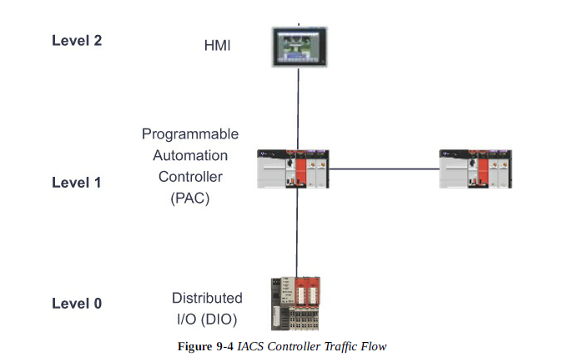
Demilitarized Zone (DMZ)-> it is the CPwE demarcation between the plant operational network and the traditional network. DMZ security is critical to plant operations as it protects the machines at the lower level from malicious activity that may occur in the traditional enterprise network.
Enterprise Zone-> it is related to traditional IT/enterprise networking functions, including file services, Internet connectivity, and email systems.

Slide 14
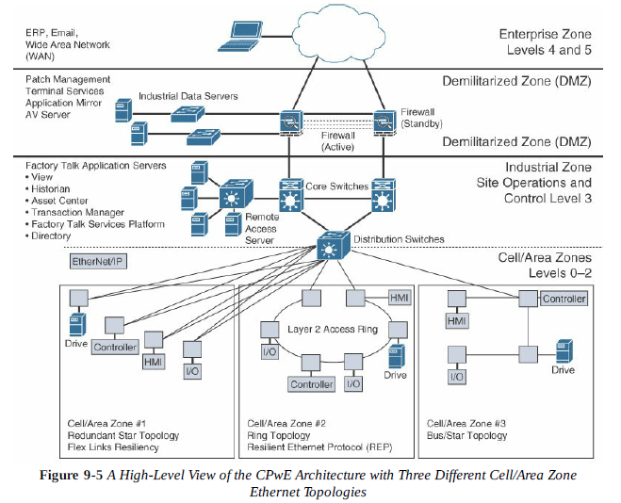
The CPwE Reference Model
Cisco and Rockwell Automation developed the Converged Plantwide Ethernet (CPwE) model, which is primarily focused on the transport of EtherNet/IP.
The CPwE solution is designed to enable the convergence of IACS applications with enterprise IT system.

Slide 15
CPwE Resilient Network Design
Due to sensitive controller and application requirements in IACS networks, network resiliency between IACS devices is a mandatory requirement within cell/area zones. Resilient IACS networks need to support the following capabilities:
Availability-> IACS applications have stringent requirements that must be considered for the LAN design, including network availability, performance and distance between equipment. For critical operations where uptime is crucial, a fully redundant physical path in the IACS Ethernet network topology should be chosen.
Predictable performance-> Meeting the predictable, reliable, and real-time traffic requirements of IACS applications is a requirement for successful CPwE deployments.
Fast network convergence-> In the event of equipment or link failure, network restoration times need to be minimized. Typical IACS application interruption tolerance limits are less than 100ms, with minimal jitter.
Industrial protocol support-> CPwE IACS devices and networking equipment need to support industrial application protocol requirements.
The following are the examples of communication patterns that require network resiliency:
Controller to HMI, controller to controller, controller to I/O, controller to variable frequent drives, controller to motor control centers.

Slide 16
Resilient Ethernet Protocol (REP)
In the CPwE reference architecture, Resilient Ethernet Protocol (REP) is used in the cell/area zone to achieve high-speed protection of ring topologies.
REP controls a group of ports connected to an Ethernet segment to ensure that no bridging loop exist and that the Ethernet segment is able to respond to topology changes.
It is not limited to small number of devices on a single Ethernet segment.
For each REP segment, one switch is designated as a master node that controls the overall ring. The master node requires 3 critical pieces of information:
Identification of the REP control VLAN, which allows the REP control messages to be communicated throughout the segment.
The location of the edges of the REP segment
The preferred place to break the ring under normal conditions, which is called the “alternate port”.
A REP segment is a chain of ports on the Ethernet segment configured with a segment ID. When all ports in the ring segment are active, one port is identified as the alternate port, meaning it is in the blocking state, thus preventing the ring from becoming a Layer-2 bridging loop.

Slide 17
If any other port in the REP segment fails, the alternate port is signaled to change state into the forwarding state, repairing the broken Ethernet ring segment and allowing communications to continue.
REP uses a loss of signal (LOS) detection mechanism to learn of adjacent neighbour failures on the segment.
When a switch port detects a REP segment failure, notification messages indicating a link failure are sent to all other REP switches.
When the notification message regarding the state change of alternate port comes, the MAC addresses in the content addressable memory (CAM) of all switches must be flushed. So, a new bridging path is formed.
REP plays an important role in improving application availability.

Slide 18
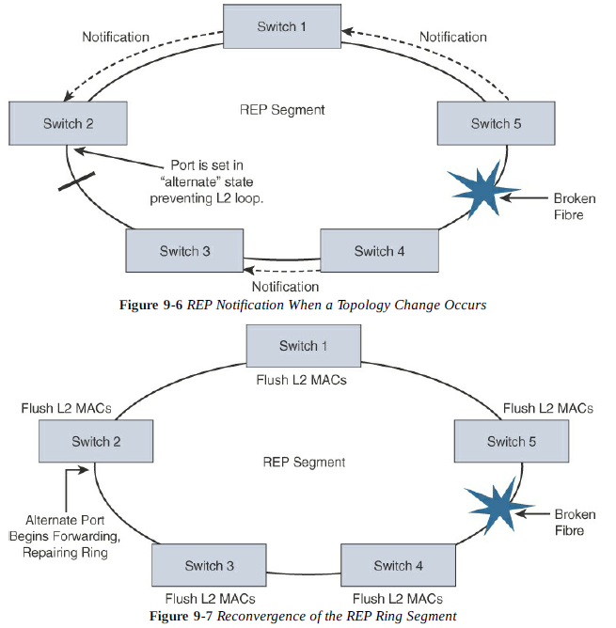

Slide 19
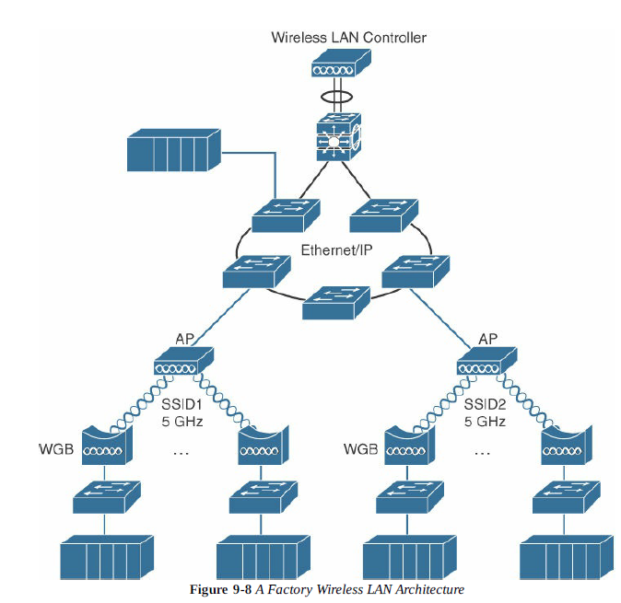
CPwE Wireless
Now-a-days CPwE is also used inside plant architecture using Wi-Fi for critical IACS applications.
CPwE wireless is having similar network requirements as ethernet along with QoS, minimal latency and jitter for critical applications.
CPwE wireless can be used to manage machines, handheld devices, and automated guided vehicles.

Slide 20
The following are several use-case examples where Wi-Fi is used in manufacturing environments:
Fixed-position devices
Nomadic devices
Operational relocation devices
Deploying a factory Wi-Fi network based on controller design principles overcome many common challenges such as shared radio frequencies, interference, and converge impairments.
The wireless LAN controller model also allows to easily deploy key technology features such as QoS, Wi-Fi security capabilities, and location services.

Slide 21
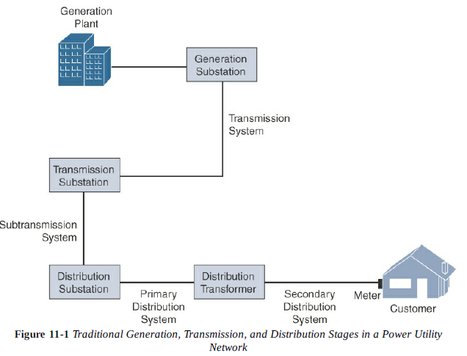
Power Utility Industry
The power supply to households typically comes in 3 stages, and supported by different companies. The 3 stages of power supply-chain are:
Generation-> includes nuclear, hydroelectric, gas, and coal plants.
Transmission-> takes HV power over long distances typically 115 kV and above over distance of 50km and greater. It includes aerial lines, submarine cables.
Distribution-> includes the part of utility network from the substation to homes and business. It includes poles, transformers.

Slide 22
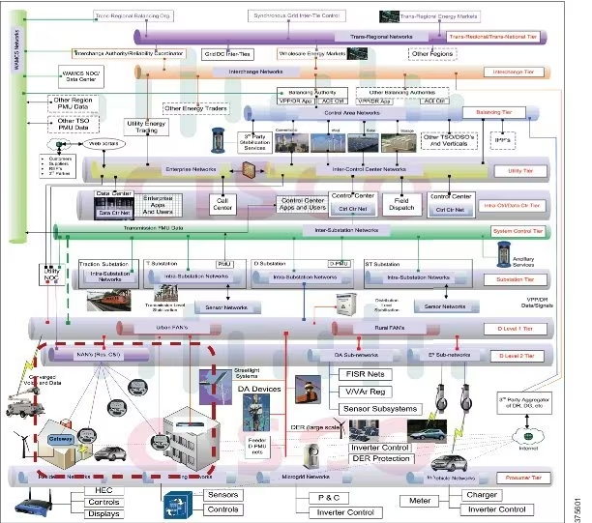
GridBlocks Reference Model

Slide 23
GridBlocks: An 11-Tiered Reference Architecture
Prosumer Tier-> combines the roles of energy producer and consumer
Distribution Tier-> this part of the grid lies between distribution substation and the end user. It contains two subtiers;
Distribution level 2 tier: this part of the smart grid network supports metering systems, demand response systems, electric vehicle recharging stations, remote terminal units etc
Distribution level 1 tier: it connects the level 2 tier networks to the distribution substation and provides backhaul services to the utility control center via the system control tier.
Substation Tier-> this includes all substation networks including transmission and distribution substations.
System Control Tier-> this includes WANs that connect substations with each other and with control centers.
Intra-control center/intra-data center tier-> this includes the utility data centers and control centers.

Slide 24
Utility Tier-> this tier is home to enterprise campus networks. It is the connection point between the control center and the enterprise network which has firewalls with appropriate security policies.
Balancing tier-> it supports connections between third-party power generation operators and balancing authorities.
Interchange Tier-> the network at this tier allows electricity to be bought and sold between utility operators.
Trans-regional/trans-national tier-> most utility grids are interconnected with much larger supergrids.
Wide area measurement and control system (WAMCS) tier-> includes connection to a critical component of the power grid, power management units, that are responsible for wide area power measurements across the grid.
Examples: primary substation GridBlock, system control GridBlock, Field area network (FAN) GridBlock

Slide 25
Benefits of GridBlocks Reference Architecture
Details a flexible tier-based model that supports incremental improvements to tiers of the grid.
Helps enable secure integration of both new and legacy technologies, improving overall manageability and visibility of network elements.
Builds on open standard primarily IP, preventing vendor dependency and also supporting interoperability and thus promoting lower costs.
Enables the consolidation and convergence of utility network, which has the effect of reducing operational and capital costs while creating new value through increased functionality.
Provides a digitization roadmap for utilities, allowing them to modernize different parts of the grid in stages.

Slide 26
Smart and connected cities
An IoT strategy for smart cities
Smart buildings
Gas monitoring
Smart parking
Water management
Road pricing
Smart city IoT architecture
Smart city security architecture
Smart city use-case examples

Slide 27
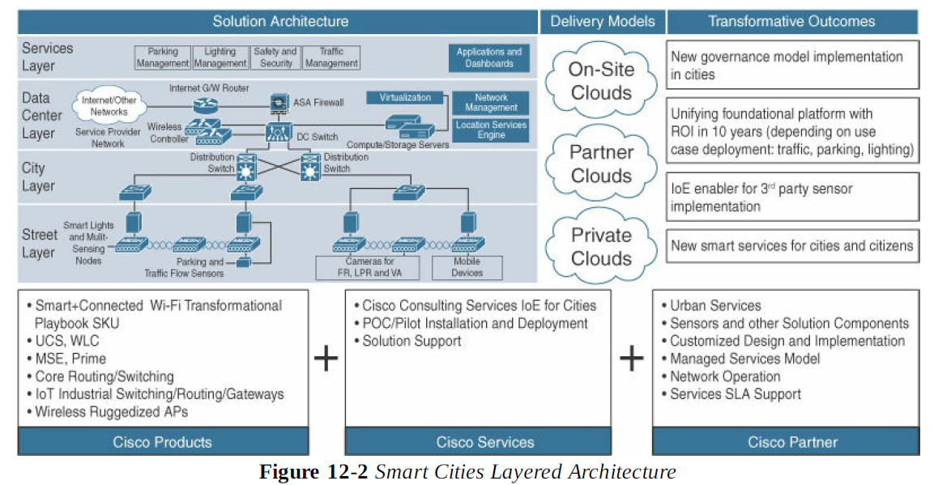
Smart City IoT Architecture

Slide 28
Street Layer
It is composed of devices and sensors that collect data and take action based on instructions from the overall solution, as well as the networking components needed to aggregate and collect data.
Variety of sensors are used at the street layer are:
Magnetic sensor-> for parking
Lighting control sensor-> can dim and brighten lights
Video camera sensor-> detecting vehicles in traffic
Air quality sensor-> can detect and measure gas and particular matter concentrations in air
Device counter sensors-> calculate number of devices in a particular area

Slide 29
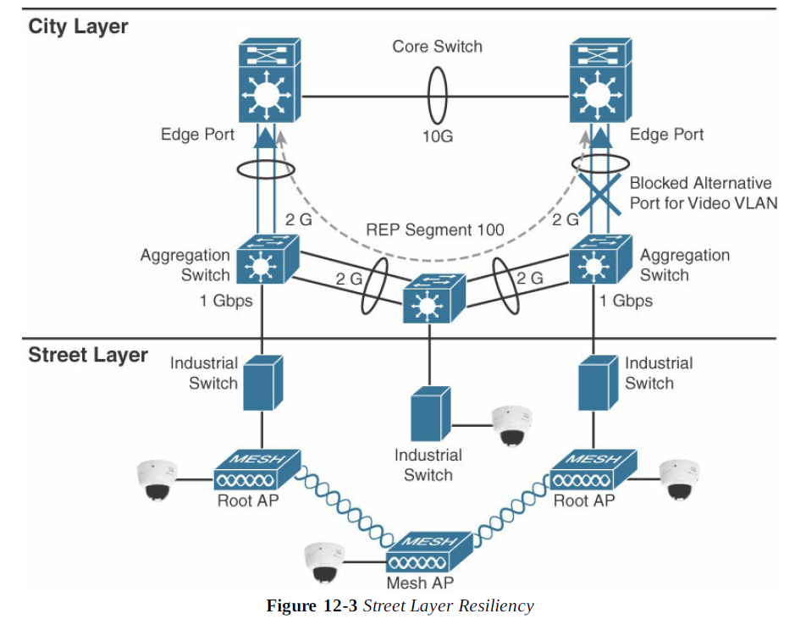
City Layer
Network routers and switches are deployed in city layer to aggregate data collected by sensors and the end-node network into a single transport network

Slide 30
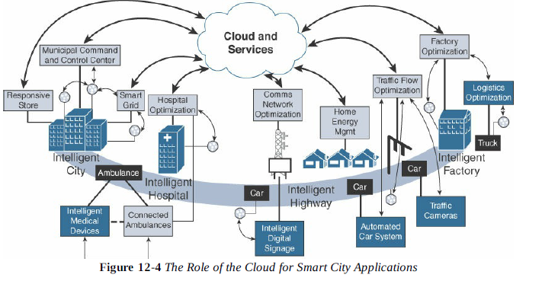
Data Center Layer
Ultimately, data collected from the sensors is sent to data center, where it can be processed and correlated. Based on this processing of data, meaningful information and trends can be derived.

Slide 31
Service Layer
Finally, the services that the measured data can provide to different users within the smart city show the true value of connectivity.
The collected data should be visualized according to the specific needs of each consumer of that data and the particular user experience requirements and individual use cases.
Example: parking data indicates which spots are and aren’t currently occupied can drive a citizen parking app with a map of available parking spots

Slide 32
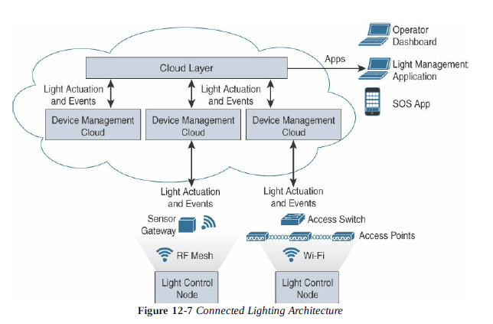
Smart City Use-case Examples
Smart Lighting->
Of all urban utilities, street lighting comprises one of the largest expense in a municipality’s utility bill. The installation of smart street lighting solution can provide significant energy saving using LED technology.

Slide 33
Smart Parking->
Added traffic congestion is one consequence of drivers looking for parking space and it has several consequences:
Contributes to pollution
Causes motorist frustration
Increases traffic incidents
Revenue loss
One option for solving urban center traffic issues is to repurpose dense urban space to create additional parking infrastructure.
Smart parking sensors are typically event-driven objects. A sensor detects an event and identifies it based on time or analysis. The event is transmitted through the device’s communication protocol to an access point or gateway which forwards the event data to through the city layer. The gateway sends it to the cloud or fog application, where it is normalized. An application shows the parking event on operator dashboards or personal smart phones, where an action can be taken.
Smart parking has 3 users that applications must support through aggregated data:
City Operators
Parking enforcement officers
Citizens

Slide 34
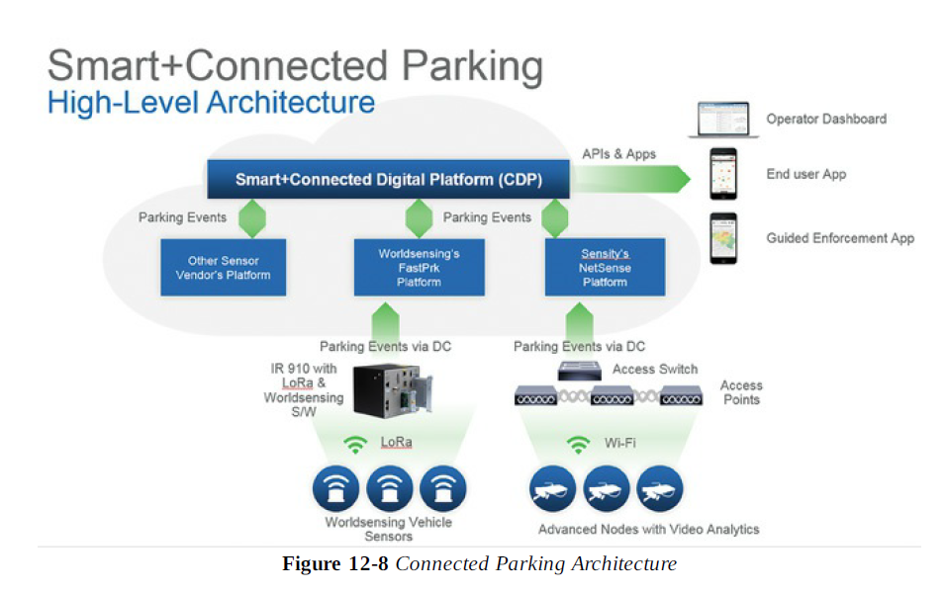

Slide 35
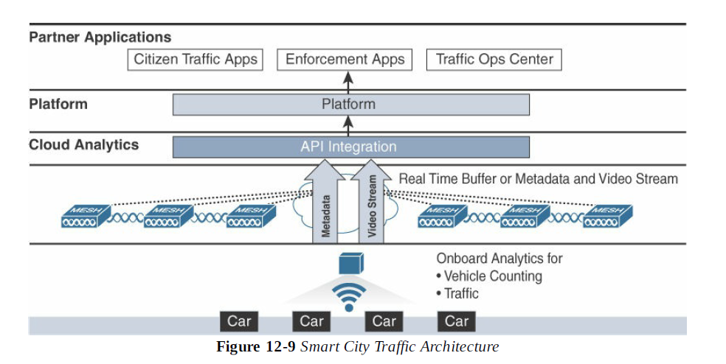
Smart Traffic Control->
A smart city traffic solution would combine crowd counts, transit information, vehicle counts etc., and send events regarding incidents on the road so that other controllers on the street could take action.

Slide 36
Smart Traffic Applications->
Traffic applications can be enabled to take immediate action with other sensors to manage traffic and to reduce pain points.
A common traffic pain point is stop-and-go, where traffic flow suddenly comes to a halt and then flows again. A well-known remedy for stop-and-go traffic is to regulate the standard flow speed based on car density. As density increases, car speed is forced down to avoid the wave effect.
Understanding a city’s real-time traffic patterns and being able to effectively mitigate the traffic issues can drive tremendous value for a city. Sensors counting devices, sensors detecting motions, sensors measuring gas concentration in the air can all leveraged to provide an estimate of traffic conditions.
The resulting estimate can be leveraged at a city level to regulate traffic flows and at a citizen level to have a better driving experience.

